Slide 1
Agenda
Enterprise and business processes
Need for Integration
Challenges to application integration
Role of ESB in integration
Advance Features

Slide 2
Anatomy of enterprise applications
Enterprise Applications keep track of information related to the operations of the enterprise
  e.g. Inventory, sales ledger
And execute the core processes that create and manipulate this information
  Process from order to cash received

Slide 3
Enterprise data
Purchases
Orders
Customers
Shipments
Marketing
Planning
Service
Inventory
Billing
Project management
Assets
Accounting
HR
Data in the organisation is captured in a number of data models
  Data models describe the way data is defined in databases or exchanged between applications

Slide 4
Mapped to functional systems
Purchases
Orders
Customers
Shipments
Sales
Marketing
Marketing
Logistics
Call centre
Service
Inventory
Planning
Warehouse
Assets
Project management
Billing
Finance
dept
HR
Accounting
HR
Originally, the process and data models were implemented in a wide variety of functional system (related to organisational departments)
Each system consisting of a database, application logic and user interface

Slide 5
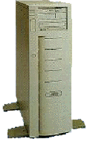


Anatomy of Enterprise
Enterprise
Business Partners
Supplier
Inventory/
Logistics
Custom Business Applications
Security Firewall
EDI
Financial
Systems
XML
Supplier hub
xCBL
Customer
Relationship Management
Enterprise Resource Planning
Marketplace
EAI
B2B

Slide 6
How we reached there
1 layer architecture
  monolithic Information Systems
  presentation, application logic, and resource management were merged into a single tier
2 layer architecture
  separation of presentation layer from other 2 layers (app + resource)
  became popular as 'server/client' systems
3 layer architecture
  can be achieved by separating RM (resource management) from application logic layer

Slide 7

Problems with function based application
Sharing of data between systems
  Data duplication
  Data inconsistency
Applications that don’t talk to one another
  Limited or lack of integrated information
Isolated decisions lead to overall inefficiencies
  Increased expenses
Therefore, there is a general requirement for integration to support organisational system capabilities
  For instance Customer Relationship Management – tracking all information about a customer across the enterprise
HR
Sales
Manufacturing
Stovepipe systems

Slide 8
Enterprise process models
Each process model captures the series of steps and interactions required to complete a specific business process
The execution of the process will impact on the enterprise data across one or more applications
A process may be executed within a single application or more often through collaboration between several applications

Slide 9
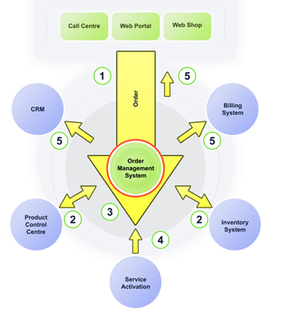
A Typical business process
A simple order management talks to a least 5-6 systems

Slide 10
Need for Integration
Unrestricted sharing of data and business processes across an organization
  Extend to customers, suppliers and regulators
The linking of data, business processes and applications to automate business processes
  Ensuring there are consistent qualities of service (security, reliability etc)
Reduce the on-going cost of maintenance and reduce the cost of rolling out new systems.

Slide 11
Technical Challenge
Heterogenous technology environments
Support for different interfaces and functionality
Variety of data format
Security requirements
Different infrastructure and interaction protocols

Slide 12
Pain Points
Fragile point to point connections
Heavy redundancy in connections
Tight dependencies between systems
Lack of flexibility and slow reaction to changing business and technology
High cost of maintaining and upgrading systems
Difficulty in diagnosing and resolving issues

Slide 13
Information System
CRM
Proprietary Interface
External Systems
Soap over HTTP
Billing
XML over RPC
Order management system
Web
Application/ PDA
Payment Gateways
Financial system Legacy Cobol

Slide 14
Integration Architecture Approach
Point to Point Architecture
Hub and Spoke Architecture
Distributed Integration Architecture or Peer to Peer Architecture
Service Oriented Architecture Integration Approach

Slide 15
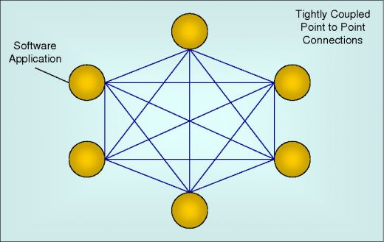
Point to Point

Slide 16
P2P
Advantages
  Point to point solutions are often fast and efficient
  The efficiency is derived from applications being tightly coupled
Disadvantages
  Complexity increases as applications increase resulting in high maintenance cost
  Lack of flexibility
  Tightly coupled nature makes it difficult to manage

Slide 17
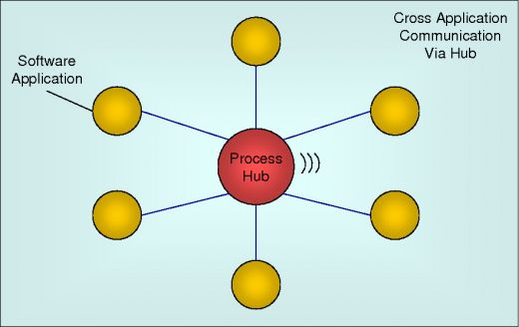
Hub and Spoke

Slide 18
Hub And Spoke
Advantages
  Less complex than Point to Point.
  Preferred architecture for achieving an easily controlled and managed environment in medium sized integration project.
Disadvantages :
  Too much processing taking place in central hub.
  Lack of standards
  Most of the solutions are proprietary hence expensive
  As the number and complexity of processes increase, performance can suffer and hubs become difficult to manage, maintain and extend
  Pure Hub and Spoke implementations do not scale well. One solution is to create a federated architecture

Slide 19
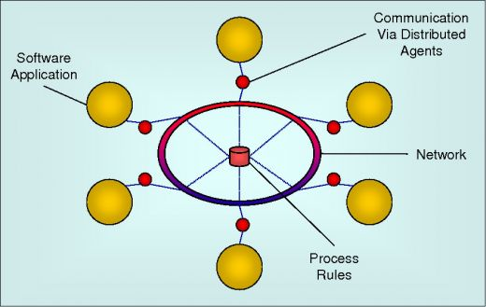
Distributed Architechture

Slide 20
Distributed Architecture
Advantages :
  Distributed work load Gain in processing efficiency Ability to scale well
Disadvantages
  Early attempts at Distributed Architecture would work only where the internal and external facilities operated under the same distributed technology (CORBA, COM, JMI).

Slide 21
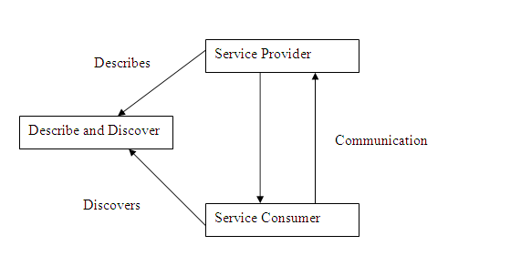
SOA

Slide 22
SOA
Advantages
  Web services as the communication standard. Loosely coupled, granular Interoperability
  Efficiency – Because of Reusable nature Scalable Reliable Secure Maintainable
  ESB has become the accepted standard for the creation of an organizations Service oriented architecture

Slide 23
SOA
SOA is a software architecture model
  in which business functionality are logically grouped and encapsulated into
    self contained,
    distinct and reusable units
    called services that
    represent a high level business concept
    can be distributed over a network
    can be reused to create new business applications
    contain contract with specification of the purpose, functionality, interfaces (coarse grained), constraints, usage
        ... of the business functionality

Slide 24
High Level View of SOA
A collection of services
services
classified into types
type
type
type
arranged into layers
  Enterprise
  Domain
  Application
Governed by architectural
patterns and policies
identification
granularity
dependency

Slide 25
SOA- what is a service?
A Service is a reusable component.
A Service changes business data from one state to another.
A Service is the only way how data is accessed.
If you can describe a component in WSDL, it is a Service.
Examples/Contexts :
  A Windows Service
    RPC Locator, EventLog, DHCP Client,
  Software Service
    Distribution Service, Alert Service
    Security Service, Log Service
  Business Service
    Common Operational Picture, Navigation
    Accounts Receivable, Customers

Slide 26
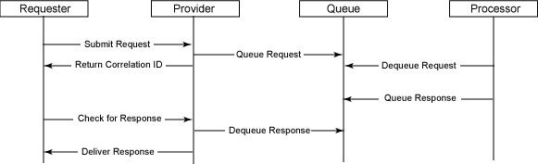
SOA : sequence diagram

Slide 27
SOA : workflow
Adheres to
Policy
governed by
Binds to
End Point
Exposes
Serves
Service
Consumer
Understands
Contracts
implements
Service
describes
Key
Sends/Receives
Messages
Sends/Receives
Component
Relation

Slide 28
SOA Reference Architecture : Enterprise View
Business participants from both inside and outside the organization
Delivery channels
Business services represent services the enterprise wants to expose to customers, partners and internal users (identified by SOMA/Service Oriented Modeling Architecture)
EIS bulk of data and logic
ESB routing, protocol mediation, and transformation

Slide 29
SOA Reference Architecture : System View
Technical overview of the architecture
Business as usual elements plus SOA related elements
Gateways (security & manageability)
ESB (adapters, queues, brokers)
Registries (several types)
  Service registry for service
  metadata
  LDAP registry for identities, access
  policies, certificates, configuration
  information
Information services to provide information to consumers in a standard format despite how or where it might be stored
Process Services provide the ability to compose services together and choreograph their behavior to carry out business processes
Security Services are enhanced to meet SOA requirements
SOA related development tools are important but not shown

Slide 30
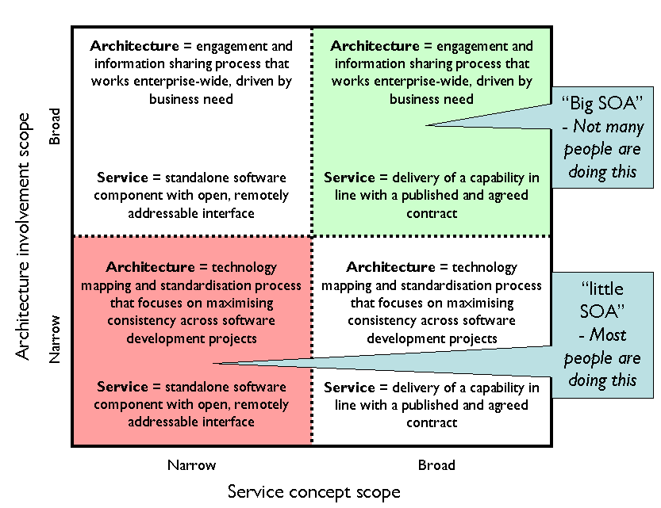
Big SOA and Little SOA

Slide 31
A Few Key SOA Protocols
Universal Description, Discovery, and Integration, UDDI. Defines the publication and discovery of web service implementations.
The Web Services Description Language, WSDL, is an XML-based language that defines Web Services.
SOAP is the Service Oriented Architecture Protocol. It is a key SOA in which a network node (the client) sends a request to another node (the server).
The Lightweight Directory Access Protocol, or LDAP is protocol for querying and modifying directory services.
Extract, Transform, and Load, ETL, is a process of moving data from a legacy system and loading it into a SOA application.

Slide 32
SOA - Governance
Policies
  Codification of laws, regulations, corporate guidelines and best practices
  Must address all stages of the service lifecycle (technology selection, design, development practices, configuration management, release management, runtime management, etc.)
Processes
  Enforce policies
  System-driven processes (code check-in, code builds, unit tests)
  Human-driven process (requests, design reviews, code reviews, threat assessment, test case review, release engineering, service registration, etc.)
Metrics
  Measurements of service reuse, compliancy with policy, etc.
  Organization
  Governance program should be run by SOA Board, which should have cross-functional representatives

Slide 33
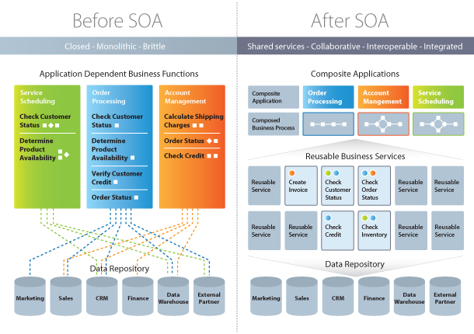
SOA Impact

Slide 34
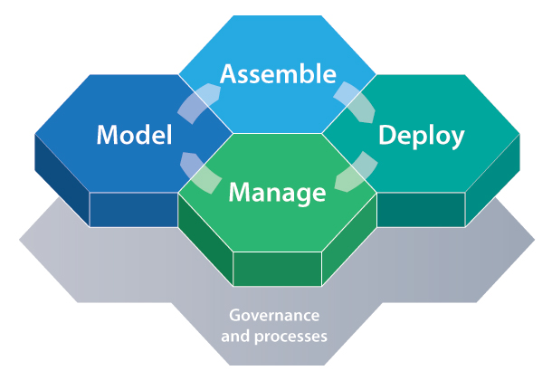
SOA Process

Slide 35
SOA - MSDN
Myth | Fact
SOA is a technology | SOA is a design philosophy independent of any vendor, product, technology or industry trend. No vendor will ever offer a “complete” SOA “stack” because SOA needs vary from one organization to another. Purchasing your SOA infrastructure from a single vendor defeats the purpose of investing in SOA.
SOAs require Web Services | SOAs may be realized via Web services but Web services are not necessarily required to implement SOA
SOA is new and revolutionary | EDI, CORBA and DCOM were conceptual examples of SO
SOA ensures the alignment of IT and business | SOA is not a methodology
A SOA Reference Architecture reduces implementation risk | SOAs are like snowflakes – no two are the same. A SOA Reference Architecture may not necessarily provide the best solution for your organization
SOA requires a complete technology and business processes overhaul | SOA should be incremental and built upon your current investments
We need to build a SOA | SOA is a means, not an end

Slide 36
ESB
  ESB is an architectural integration pattern that provides a flexible infrastructure that enables dynamic and adaptable integration
  Enterprise Service Bus (ESB) provides an infrastructure to implement this SOA concept. Instead of going back again to point to point integration to implement SOA, ESBs extend knowledge gained in EAI work that simplifies the integration and flexible use of business components.

Slide 37
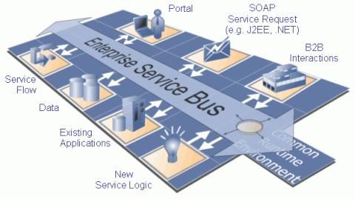
ESB

Slide 38
ESB
An ESB is typically defined by the list of services it provides. Services commonly included are:
  Transport mediation—not all applications and services that need to be integrated use HTTP or JMS.
  Dynamic message transformation—not all services use SOAP and are unlikely to require the same message structures.
  Intelligent routing—not all messages emanating from a source are intended for the same destination. The target destination will likely depend on some criteria inherent in the message.
  Security—only authorized and authenticated users need have administrative access to the JBoss Fuse runtime; services and brokers that handle sensitive information may restrict access by unauthorized or unauthenticated clients only; similarly, messages that contain sensitive information may be encrypted as they transit their routes.

Slide 39
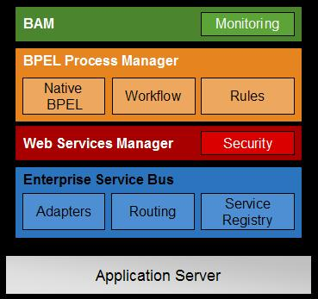
Role of ESB in SOA

Slide 40
Basic services
Service
Clients
Service Bus
Enterprise Application
Service Messaging
WS-RM
Application
Client
HTTP/SOAP
Application
Request / Response
Application
Client
JMS
TUX
Synch / Asynch
Application
Application
Client
FTP
MQ
Application
Split / Join
EJB
Application
Client
REST
Application
Application
Client
File
Publish / Subscribe
JCA
Application
Any to Any Protocol
Any to Any Payload
  XML
  non-XML
  Binary
No WSDL Required
Multiple communications paradigms
  Request/response
  Synchronous and asynchronous
  One-to-many, many-to-one
  Pub-sub
  Mix-and-match (e.g. sync-to-async)

Slide 41
Routing
Location Transparency
Point to point mesh up problem is resolved
Process A
Host
Service Bus
Host

Slide 42
Routing
Content Based Dynamic Routing
Point to point mesh up problem is resolved
Customer A
Service Bus
Old System
Routing
New System
Customer B

Slide 43
Transformation and Enrichment
Backwardly compatible
Rating agency
Applyloan
Service Bus
Bank

Slide 44
Orchestration
Service bus can be used to create new service orchestrating multiple applications.

Slide 45
Development
Abstracts low level nitty grities
Incremental development
Reduced integration complexity, cost, and manual intervention
Accelerated the development and testing process

Slide 46
Non Functional Aspects
Scalability
  Load Balancing
High Availability
  FailOver
Performance

Slide 47
Advance Features
Business Activity Monitoring (BAM)
Throttling
Delayer
Tracer
Managed

Slide 48
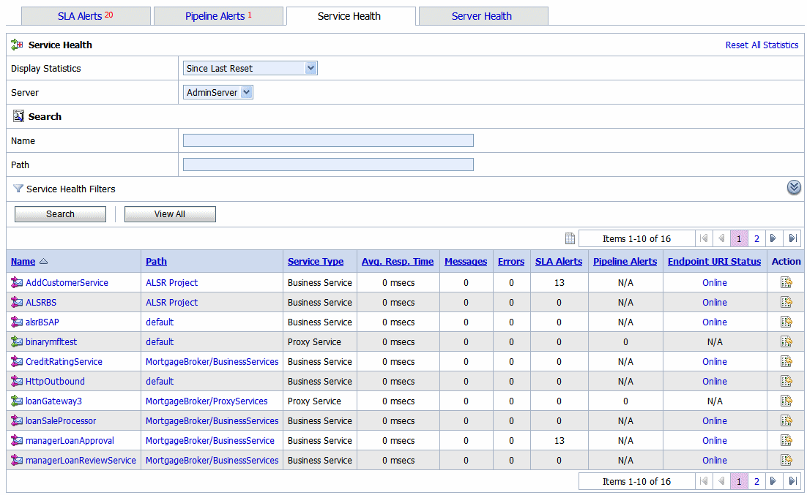
Monitoring
Monitoring Dashboard
Service health check on each run
Running count statistics for service
Service level alert
Throttling Information

Slide 49
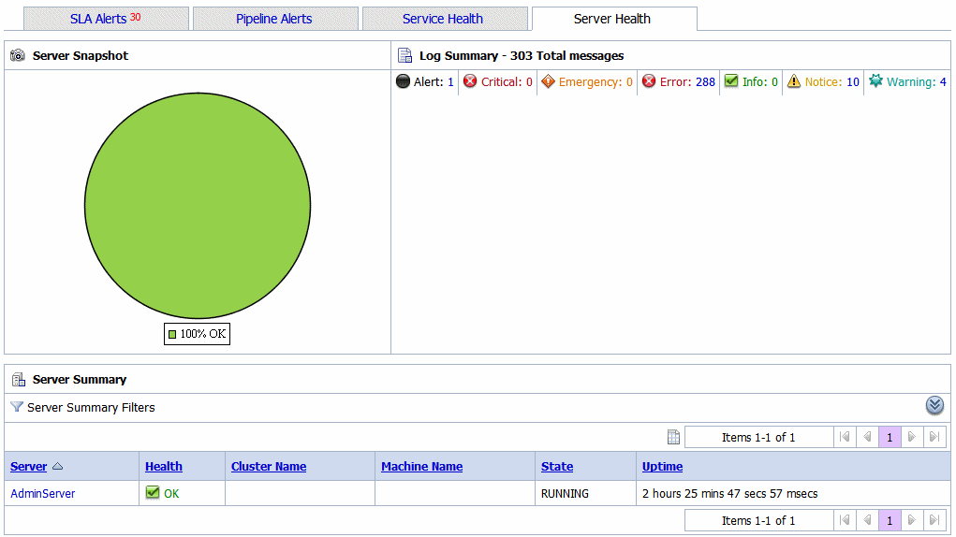
SLA Tracking

Slide 50
Players
Open Source
  Mule
  ServiceMix
  Fuse
Others
  Oracle Service Bus
  IBM

Slide 51
Conclusion
The end result is the ability to undertake integration projects using ESB can:
Focus specifically on high-value business issues and deliver rapid ROI
Offer a low-cost alternative to traditional EAI models
Extend across the enterprise as more business operations are offered as services
Re-use these assets by using a ‘building block’ approach to application development
Integrate with third parties
Help avoid reliance on high-cost skills associated with proprietary or custom-built solutions

